Slide 1
Lighting and Rendering in the Unity Game Engine
Project Showcase Awais Tasleem
Supervisors: Lee Speakman and Sadaf Hina
Degree Programme: Computer Science with Industry Placement

Slide 2

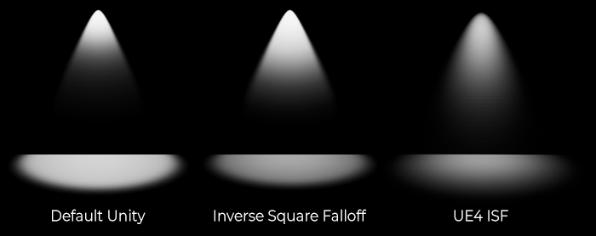
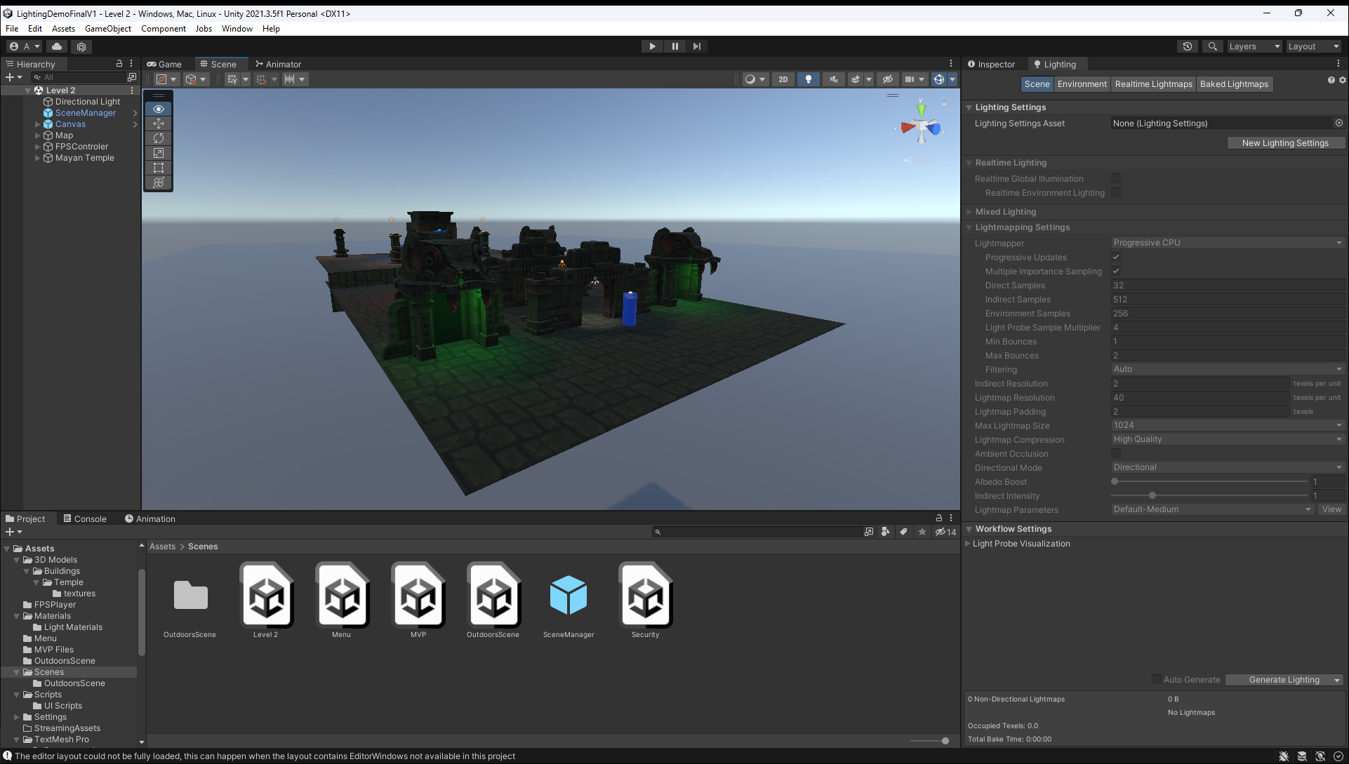
Purpose
The main purpose of this project was to show how different lighting techniques are used in the Unity game engine to create games.
This has allowed me to understand the underlying methods that Unity game engine uses to produce different types of lights such as spotlights and area lights.
It has also shown me how the game developer can manipulate the light to shows different aspects of the game, such as the direction a player needs to go or to highlight an object and set the atmosphere of the game world.

Slide 3

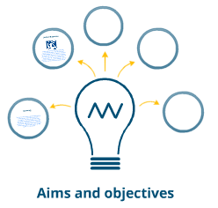
Aims and Objectives
This project aims to explore the different lighting techniques used by developer to produce realistic lighting in the Unity Game Engine. It also aims to show players what the security issues are in games and in the game development process.
Objectives
Research how lighting works in unity by using the Unity Engine’s.
Make a minimal viable product that has a simple scene, user interface and game mechanics.
Research DRM security measures and different security stories in the gaming industry and implement a method to show the player this information into the demo.
Design and build a complete lighting demo with all the aspect of the project included.
Run different testing methods such as user testing with people so they can give feedback to me about the demo and to make sure the demo is working and there only a small number of bugs.

Slide 4
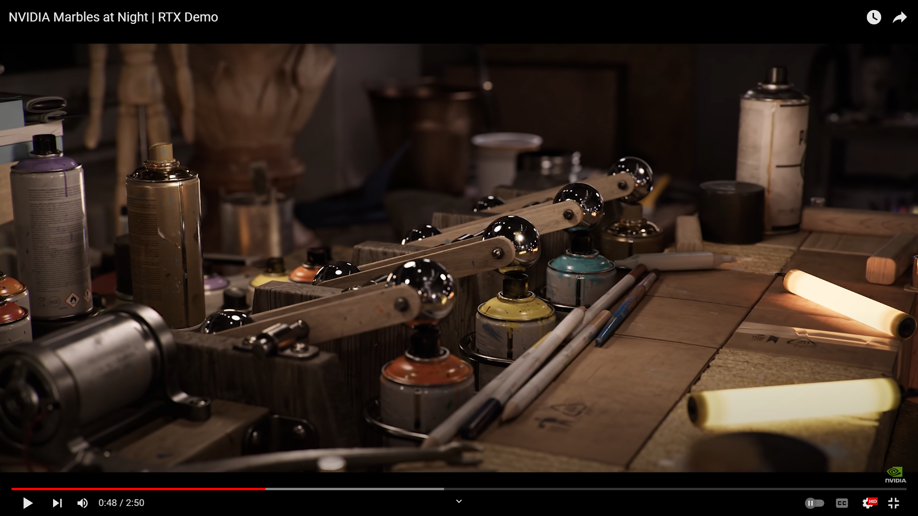
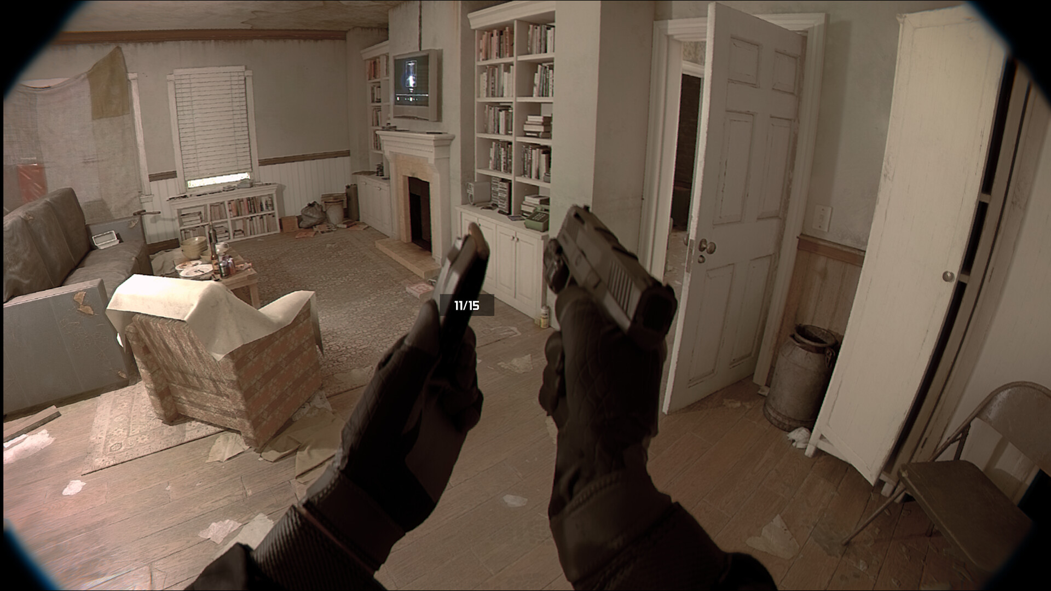
The state of lighting in Game Development
Lighting is always expanding in the game development industry. An example of this Nvidia Ray Tracing technology that uses lighting techniques to mimic how rays of light bounce in the real world.
During development, there has been a major release of a game demo that uses the Unreal 5 Engine. The game demo has graphics and lighting that is almost life-like, that it can be mistaken for real life police camera footage.
Notes:
NVIDIA Marbles at Night | RTX Demo – YouTube
They have a special line of graphics cards called the RTX line that focus on getting the best raytracing performance as it is very intensive of older graphics cards. //talk if there is time
Unrecord on Steam (steampowered.com)
The Unreal 5 game demo used different techniques to achieve such as, 4K Textures and different lighting techniques

Slide 5
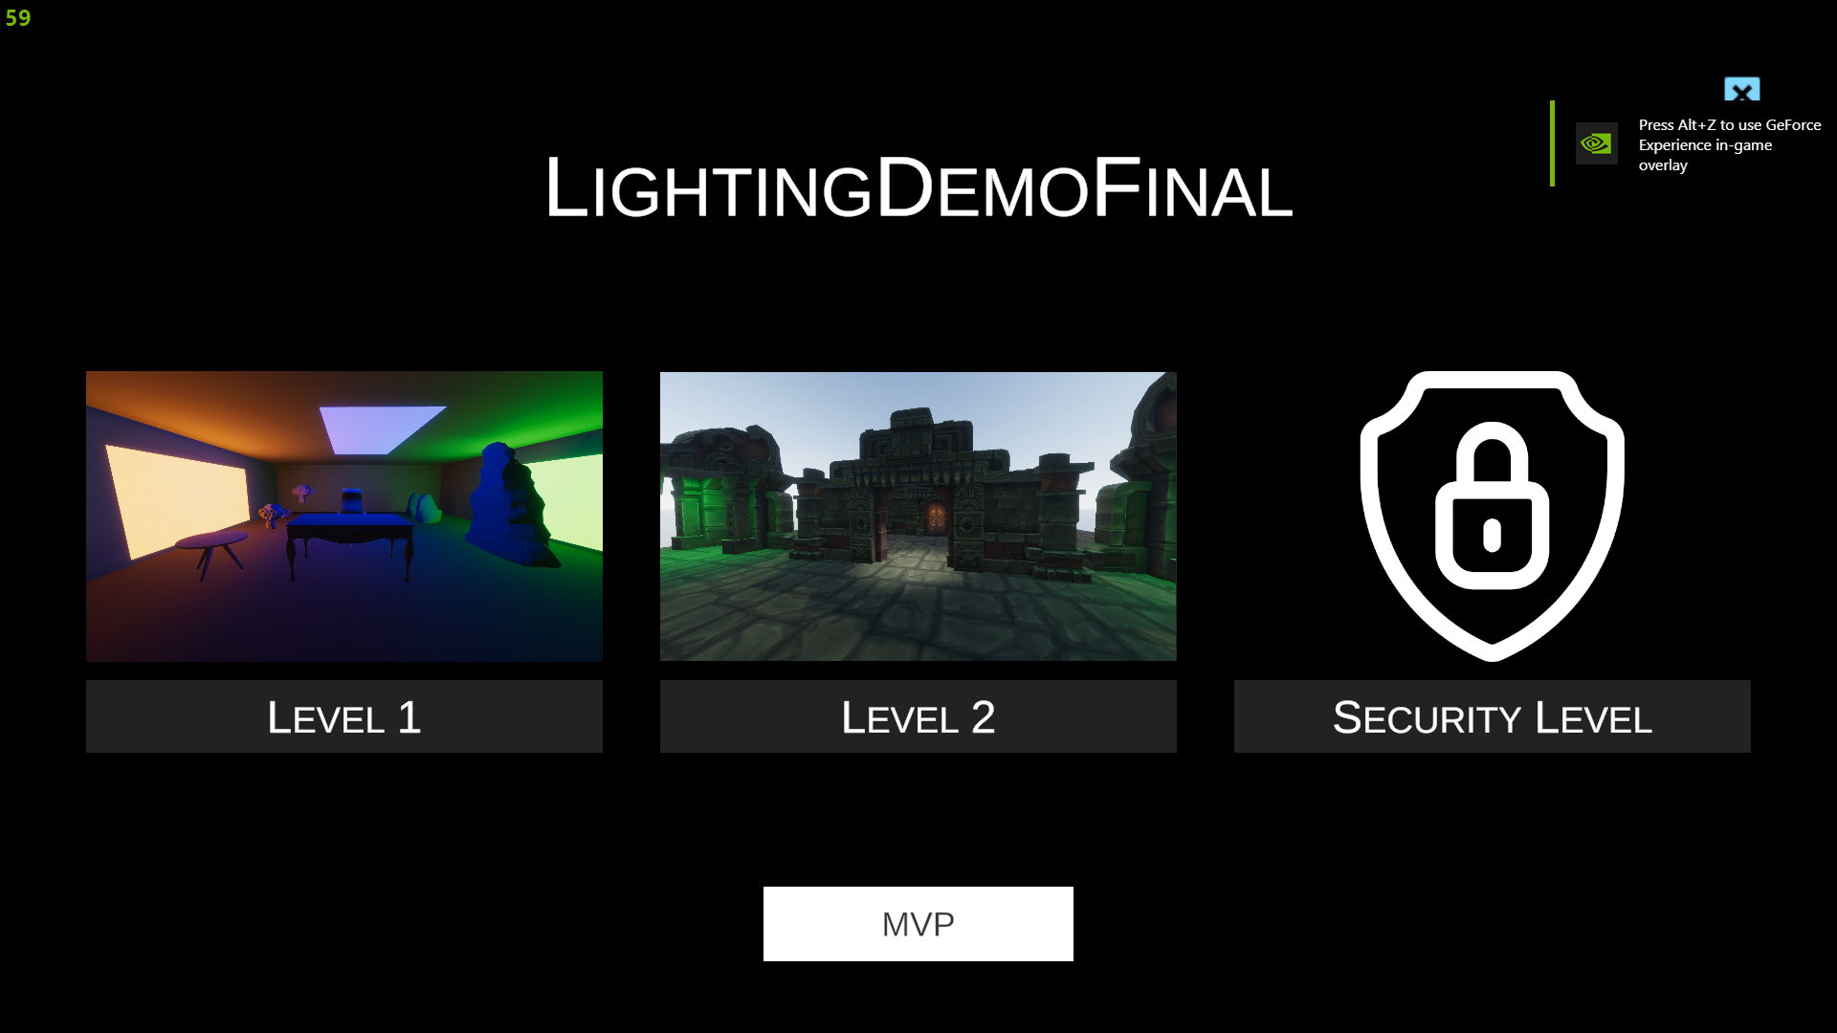
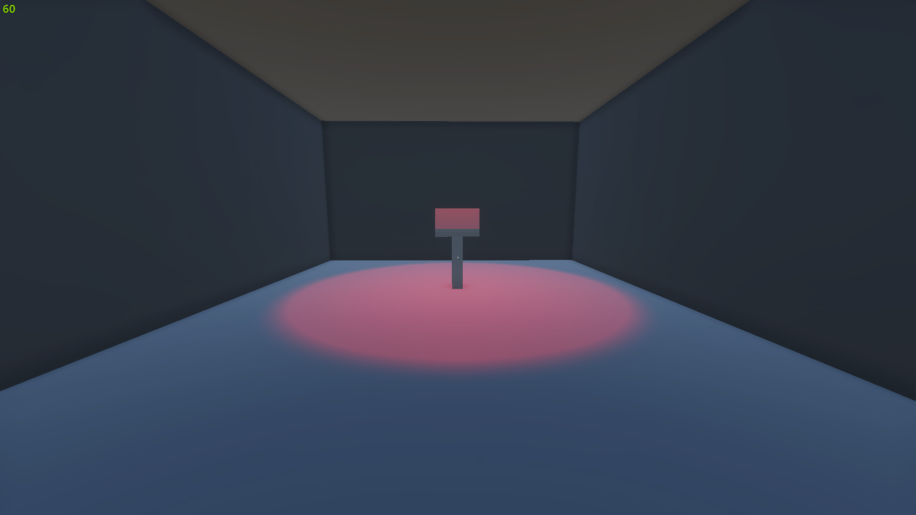
Design
The demo has 4 main design concepts:
Corridor for decision making.
Light room to show baked Lighting.
Mayan Temple for Real Time Lighting.
4 Alter's for giving players security information and missions.

Slide 6
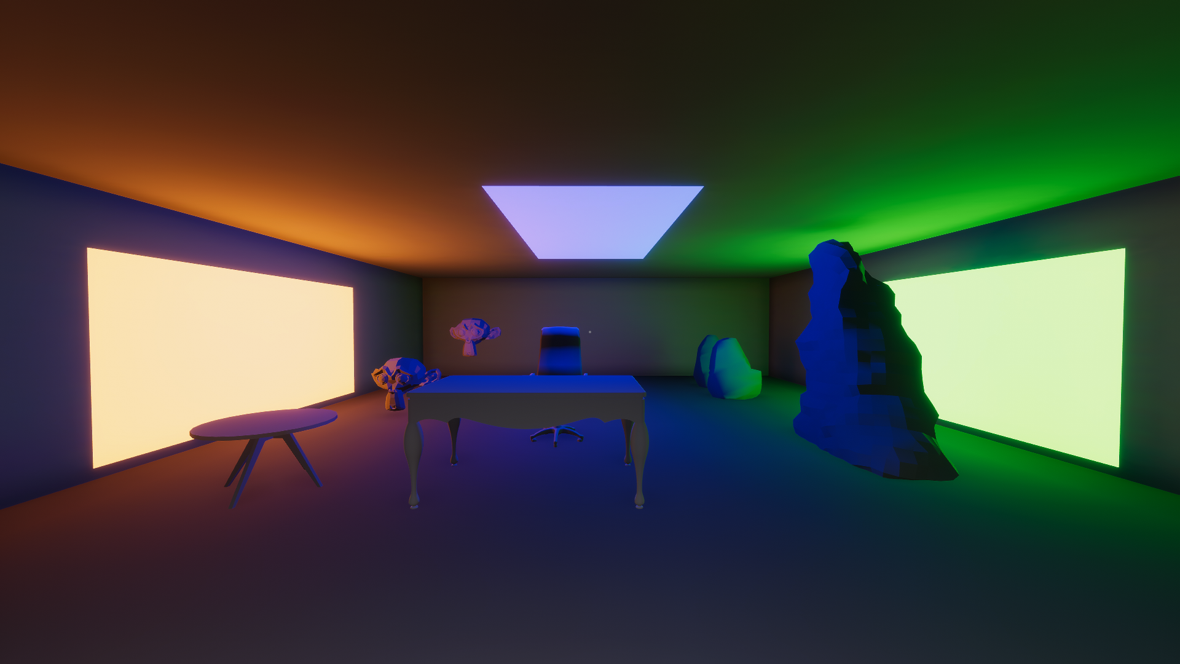
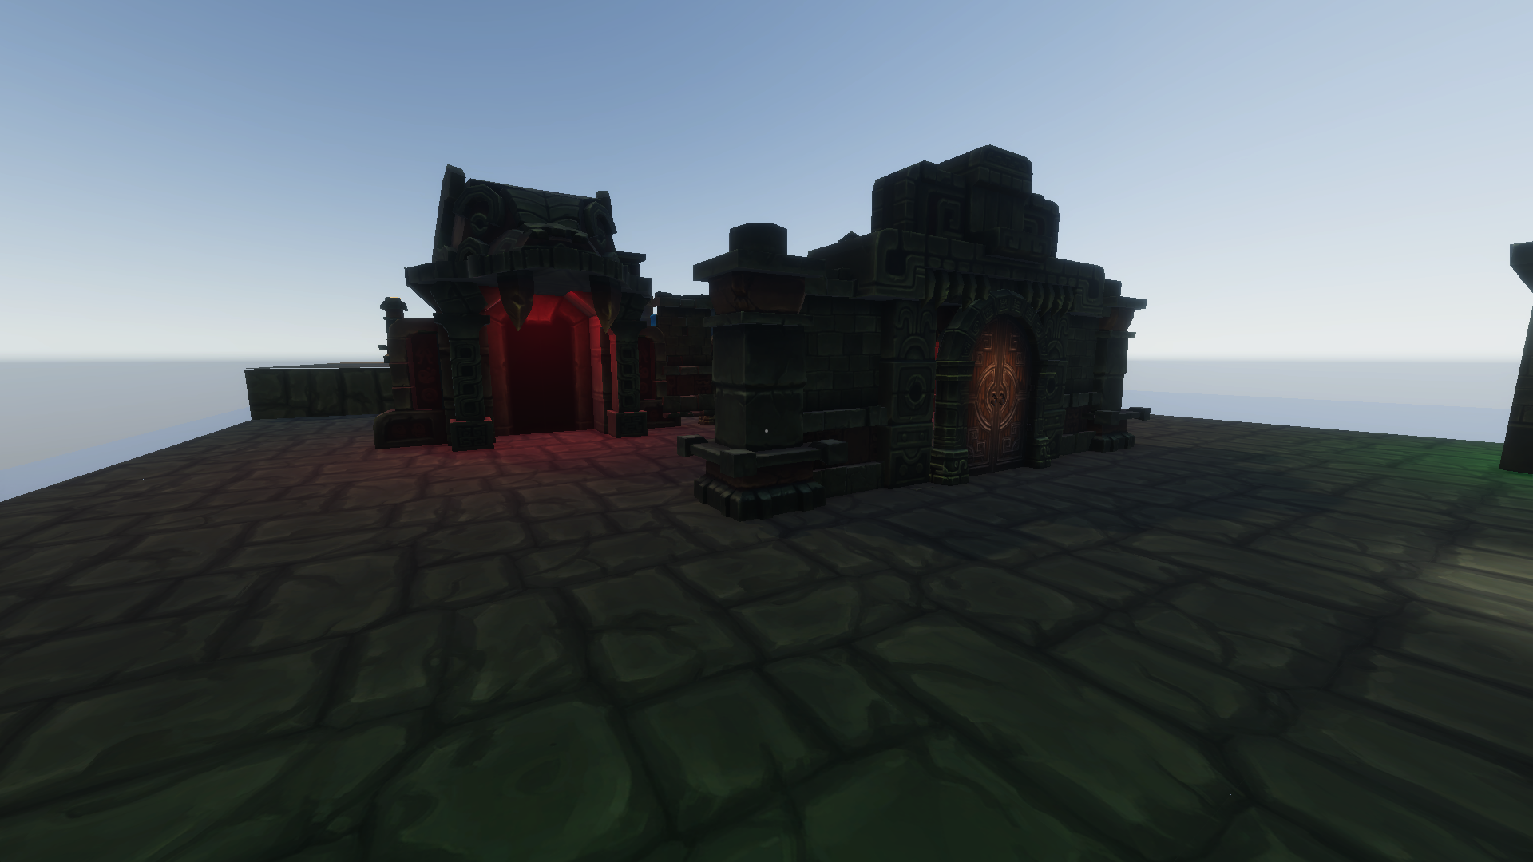
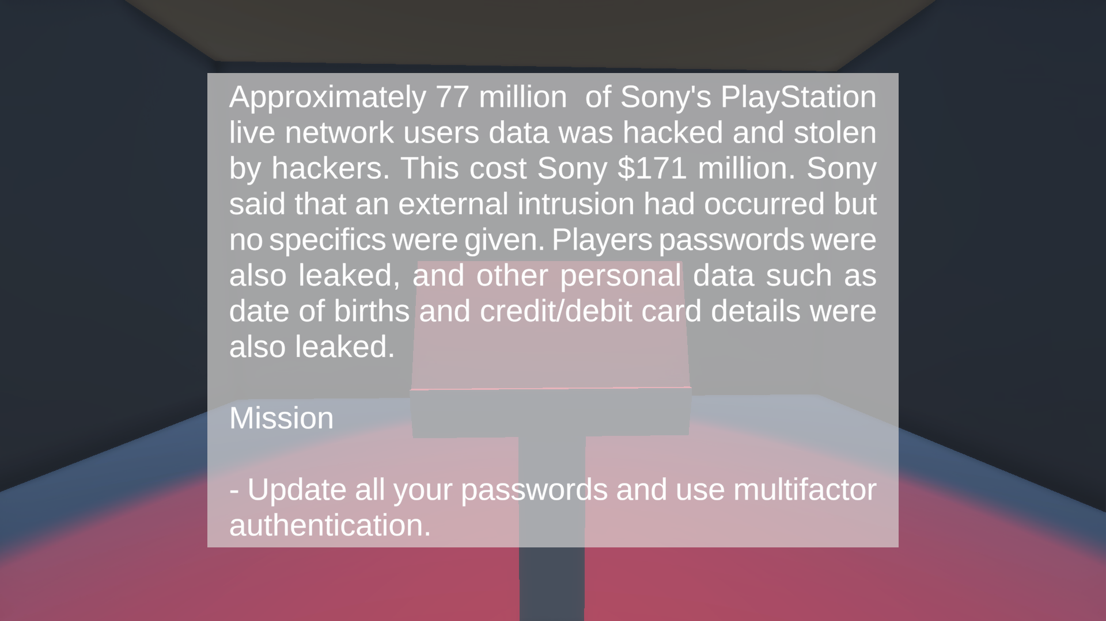
Implementation
The demo was created using the Unity Game Engine and programmed in C#.
There are 2 types of Lighting processes in the demo, baked lighting and Realtime lighting.
Baked lighting consists of calculating the lights before runtime and saving the results in a look up table.
Realtime lighting is doing the light calculation at runtime.
There is also a level that shows the player different news stories about cyber security in the gaming industry.
Notes:
Order
1. Unity can also do ray traced lighting, but I didn’t have the correct hardware and time to do this.
2.Baked Lighting
When the player goes to an area where baked lighting is, the engine will fetch the correct lighting data from the look up table.
This is to save performance as lighting calculation are very performance heavy and it would reduce the framerate of the game.
3.Realtime lighting
This is similar to raytraced lighting, but the light is calculated in a different way. It calculates the global illumination from a single point of light such as a sun.
4. It also gives the player a mission to complete.

Slide 7
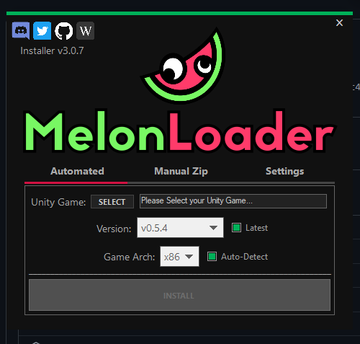
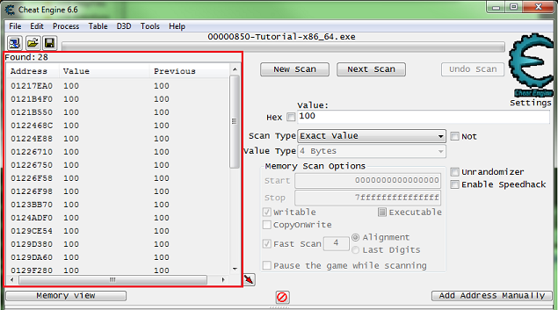
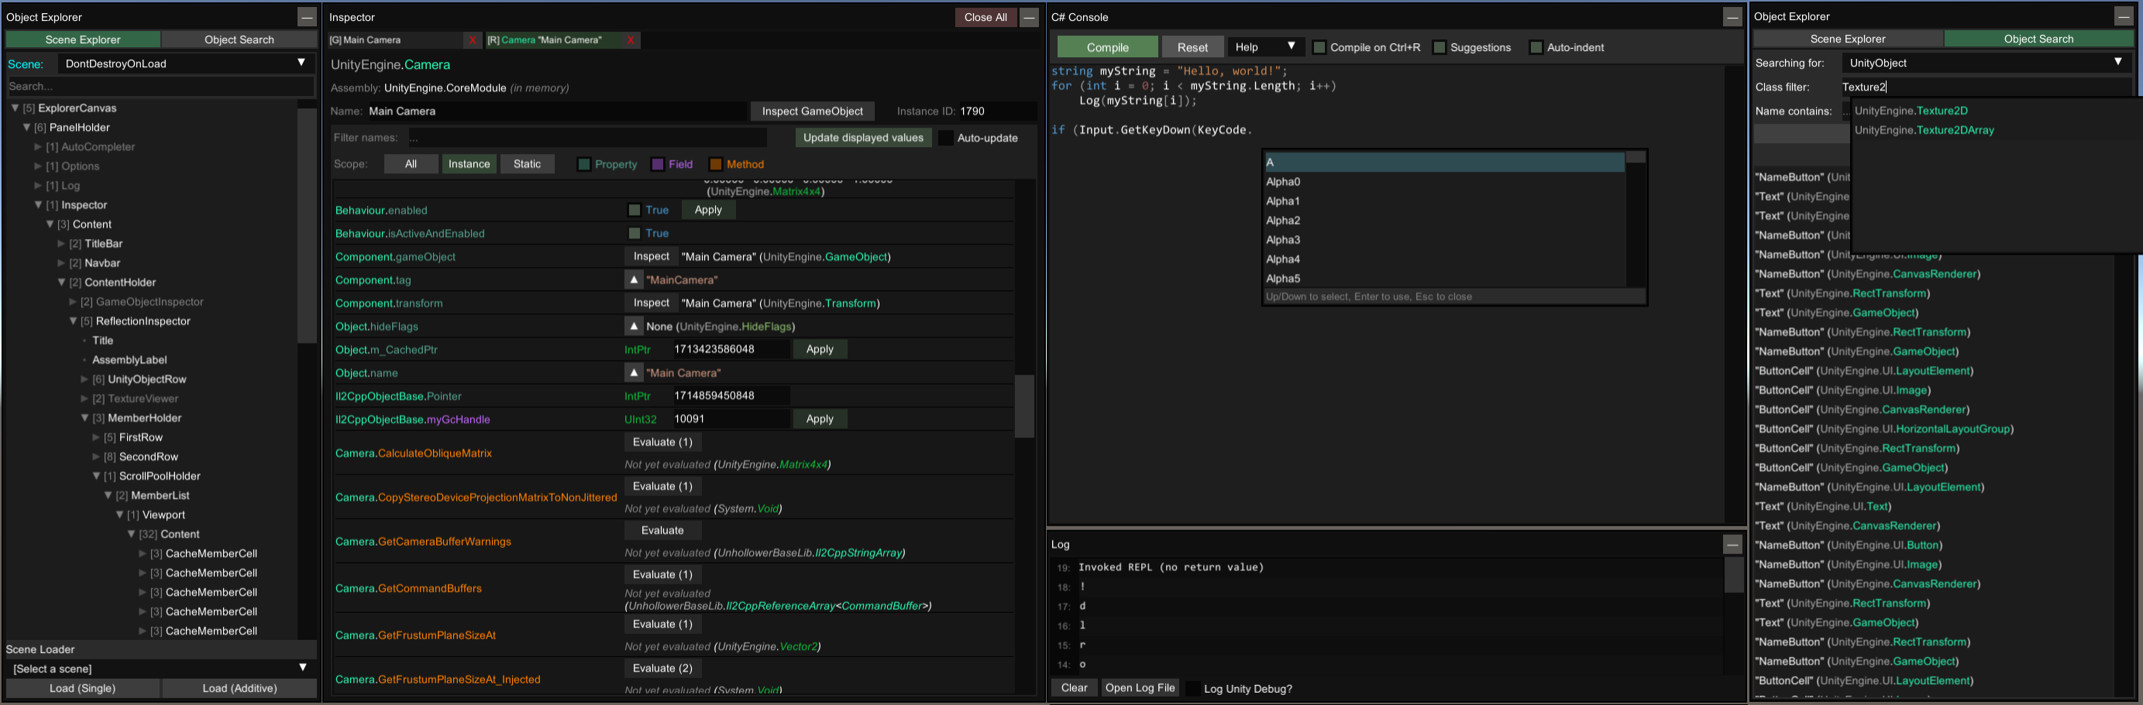
Security Research
The main way that Unity games are attacked is by using an Application called Melon Loader which exploits IL2CPP.
Before hackers would need to manually decrypt the unity executable file to get the games methods and classes and variables, but ‘UnityExplorer’ does it automatically.
Notes:
Intermediate Language to C++ = IL2CPP
Melon loader allows you to run your own C# code in a unity game.
There is a tool called cheat engine that is used to externally manipulate the games memory to increase the score or give the player more money.

Slide 8
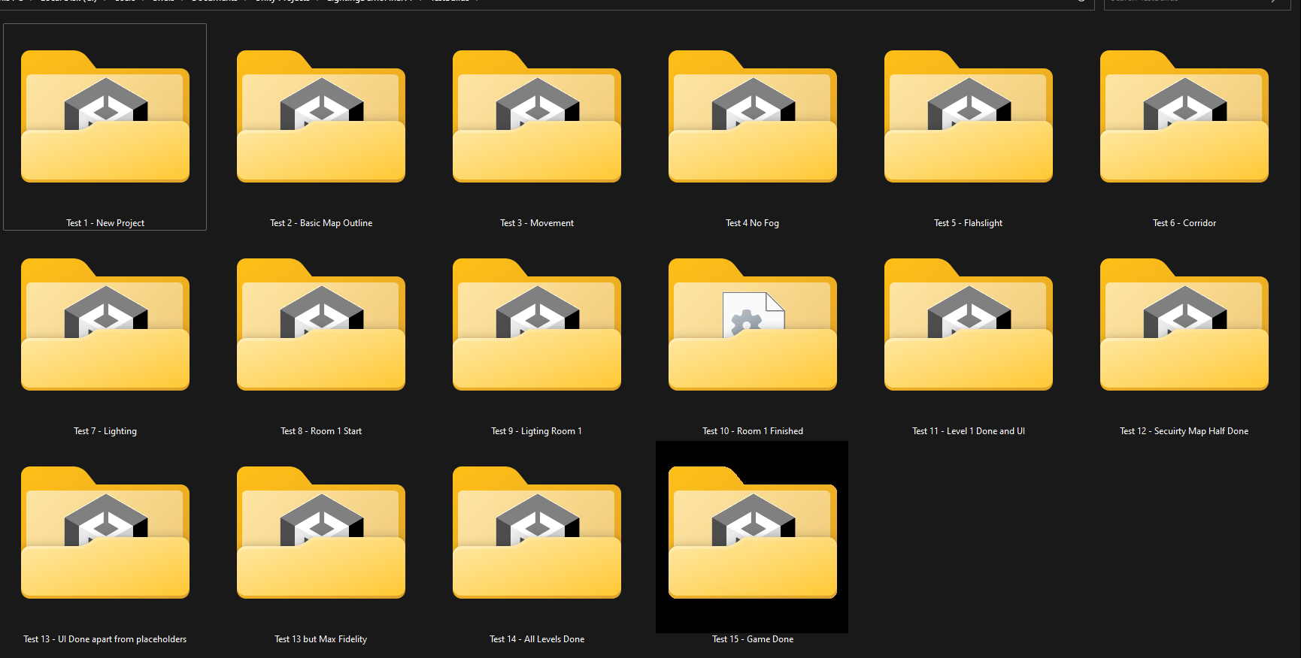
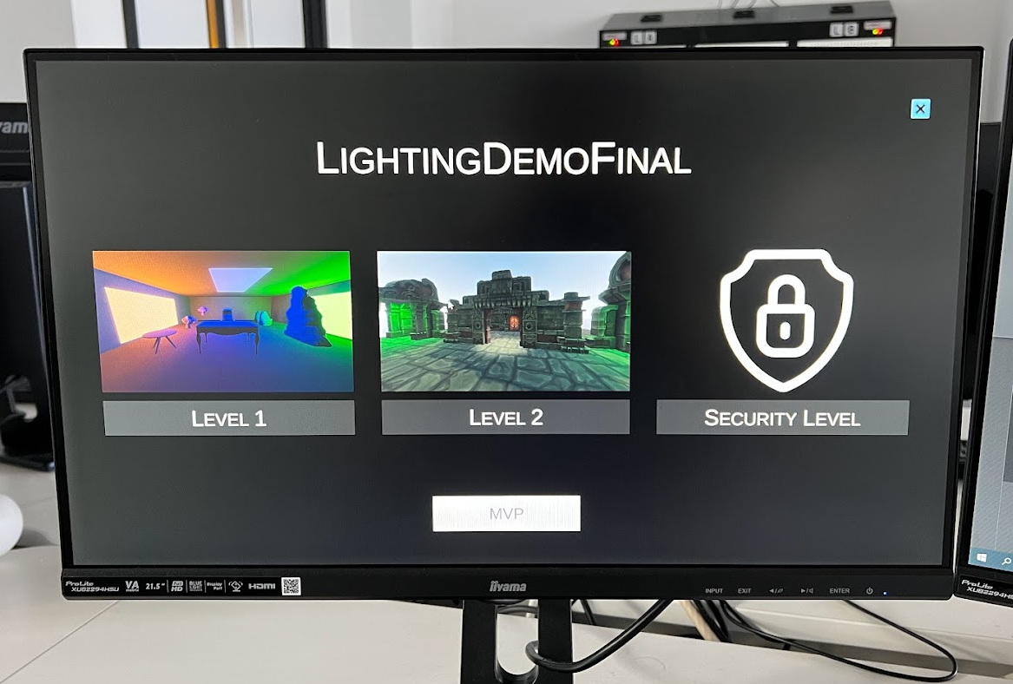
Testing
The testing mainly consisted of continuous testing by continually play-testing the game and
continually building the game to make sure that the game would build with no errors and to make sure that the performance was good enough for the project.
The usability was also tested by giving the built game to the tester (Friends and family)
and getting feedback from them based on each test, for example, sensitivity of the
mouse when looking around.
Notes:
Top photo shows the test builds
The bottom photo shows the game running on University PC.

Slide 9
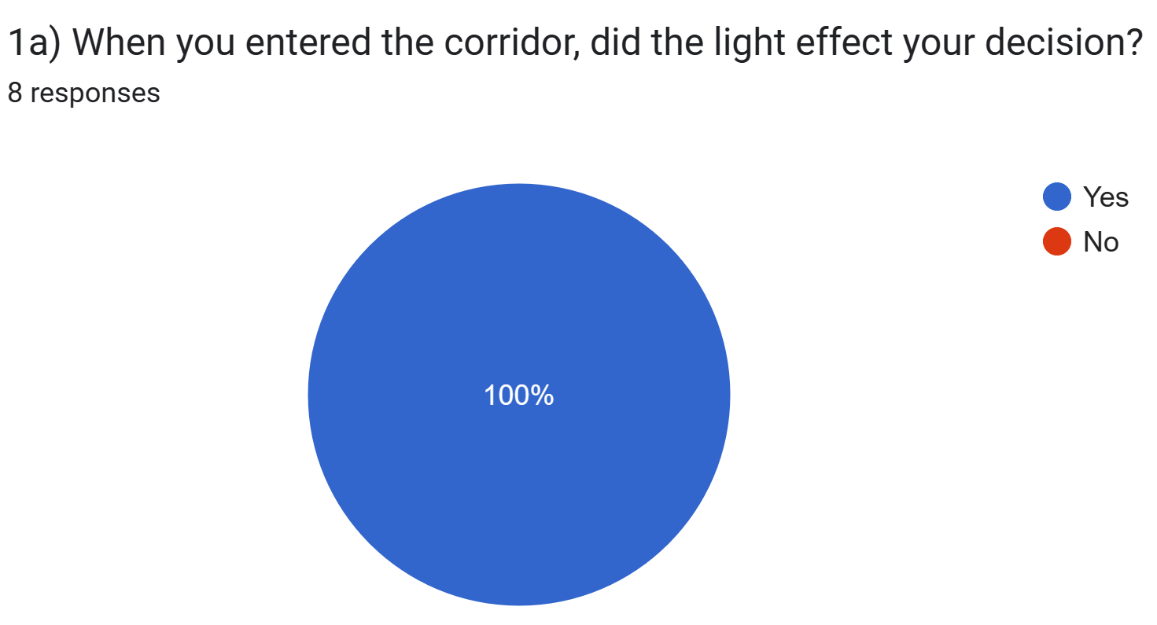
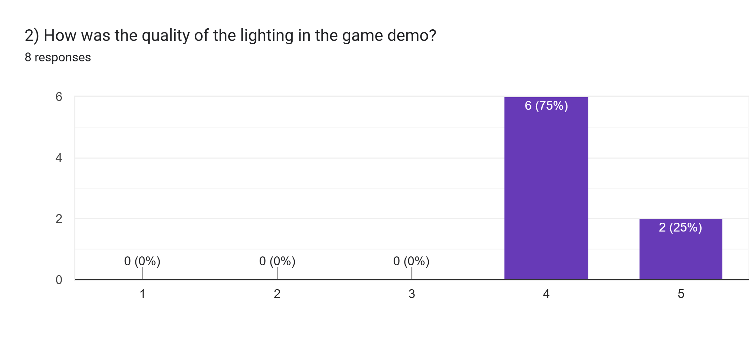
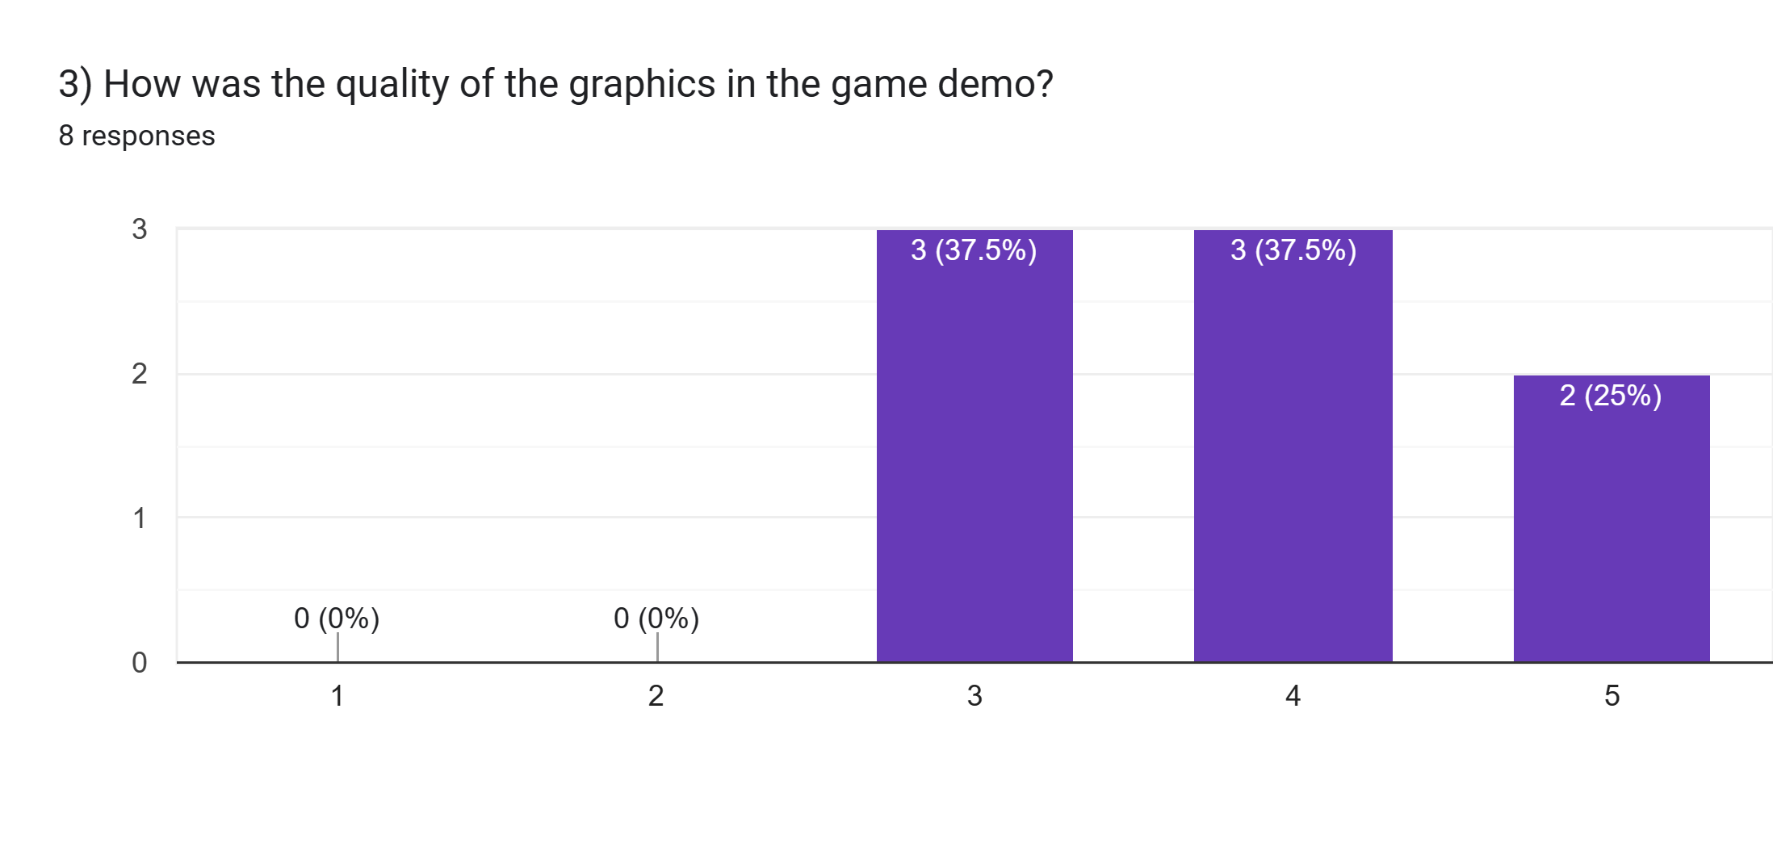
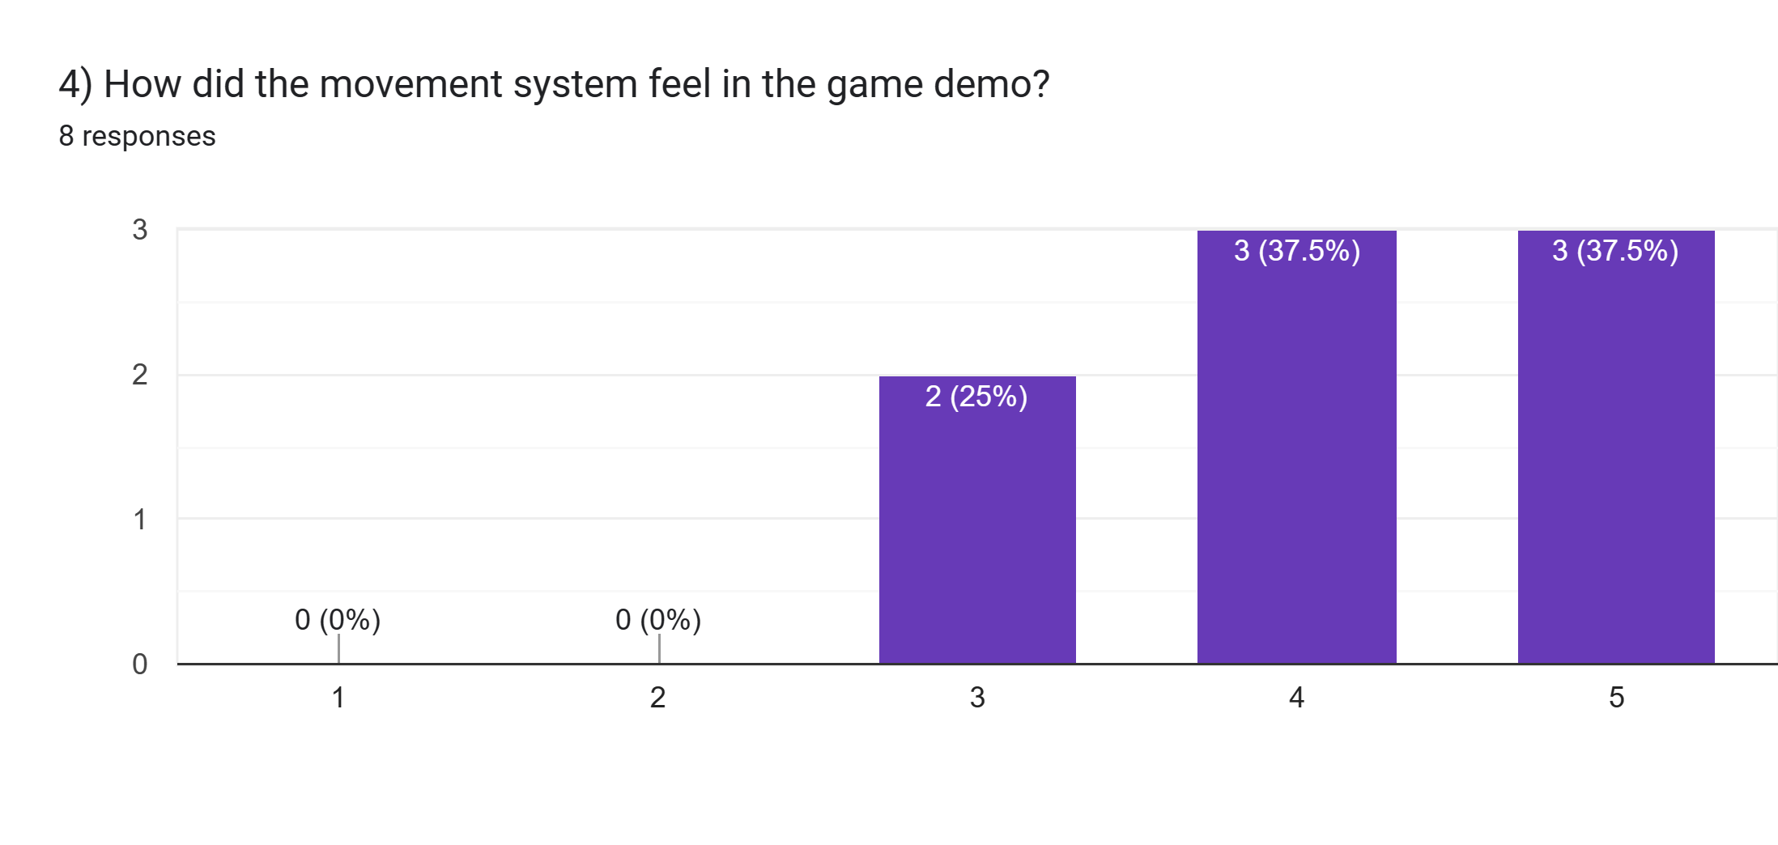
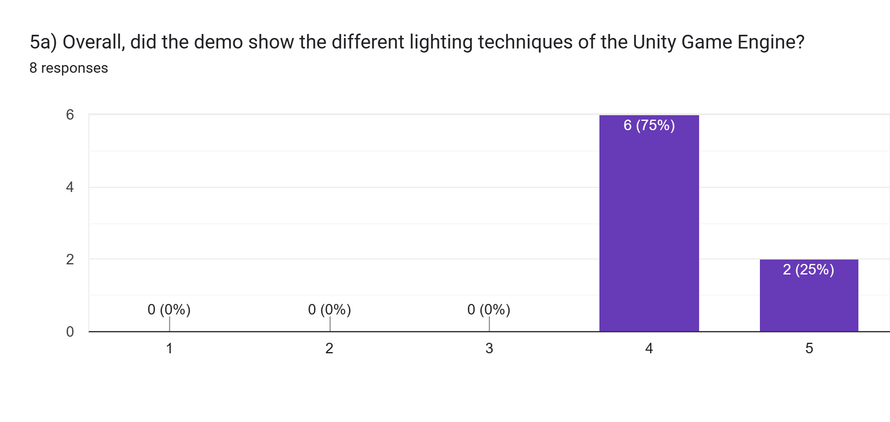
Results
Notes:
Overall, the feedback given was mostly positive and there weren't many issues that the testers noticed.

Slide 10
Challenges and Conclusion
Technical Challenges faced:
Demo not compatible with University Computers
Optimisation on lower end hard due to Unity HDRP Pipeline
Other Challenges faced:
Construction work in my house, reduced development time.
Covid-19 illness wasting over a week of development.
If I were to do this project again, I would use the Universal Render Pipeline instead of the current High-Definition Pipeline as it would let the demo run on lower end hardware
Overall, I believe this project was a success as it hit the main objectives and the feedback from the users that tested the project was also excellent and positive. There were a few issues to fix during the development of the project, but they weren't too hard for me to solve.

